Slide 1
Intro to ksqlDB
Pravin Y Pawar

Slide 2

ksqlDB
What?
An event streaming database purpose-built to help developers create stream processing applications on top of Apache Kafka
A component of Confluent Platform
owned and maintained by Confluent Inc. as part of its Confluent Platform product
licensed under the Confluent Community License
Allows you to build stream processing applications on top of Apache Kafka
with the ease of building traditional applications on a relational database
using SQL to describe what you want to do rather than how
makes it easy to build Kafka-native applications for processing streams of real-time data
Some key ksqlDB use cases include:
Materialized caches
Streaming ETL pipelines
Event-driven microservices
ksqlDB

Slide 3
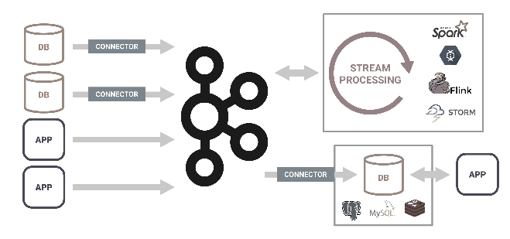
Building stream processing applications
One way
In today’s world, applications that leverage stream processing need a heavyweight architecture
requires integrating several distributed systems together
often include a fleet of connectors or agents for acquiring events from the outside world, durable storage to house these events
makes use of a stream processing framework for processing the events, and a database to serve aggregations of events to applications
Unfortunately, the parts don't fit together as well as you'd hope
all of these systems are complex, and each integration is a small project to figure out
like trying to build a car out of parts, but the parts come from different manufacturers who don't talk to each other
ksqlDB

Slide 4
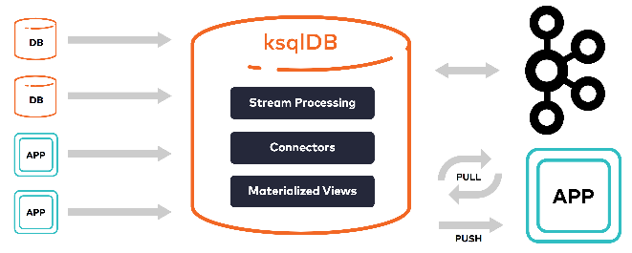
ksqlDB to build stream processing applications
Why
Shouldn't be this difficult to build stream processing applications!
ksqlDB greatly reduces the operational complexity required to build stream processing applications
enables you to build real-time systems without requiring significant time and overhead
combines the power of real-time stream processing with the approachable feel of a database, through a familiar, lightweight SQL syntax
natively powered by Apache Kafka, it seamlessly leverages the underlying, battle-tested event streaming platform
ksqlDB

Slide 5
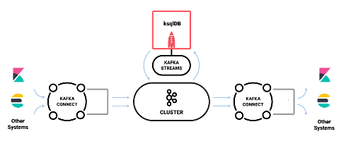
What Can I Do With ksqlDB?
Usecases
Streaming ETL
ksqlDB makes it simple to transform data within the Kafka pipeline, readying messages to cleanly land in another system
Real-time Monitoring and Analytics
Track, understand, and manage infrastructure, applications, and data feeds
by quickly building real-time dashboards, generating metrics, and creating custom alerts and messages
Data exploration and discovery
Navigate and browse through data in Kafka
Anomaly detection
Identify patterns and spot anomalies in real-time data with millisecond latency
enabling to properly surface out-of-the-ordinary events and to handle fraudulent activities separately
Personalization
Create data driven real-time experiences and insight for users
Sensor data and IoT
Understand and deliver sensor data how and where it needs to be
Customer 360-view
Achieve a comprehensive understanding of your customers across every interaction through a variety of channels
where new information is continuously incorporated in real-time
ksqlDB

Slide 6
Building blocks of ksqlDB
The core categories that are foundational to building an app:
Collections
Streams
Tables (Changelog Streams)
Materialized views
Queries
Pull
Persistent (Push)

Slide 7
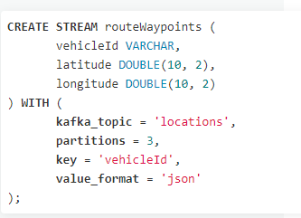
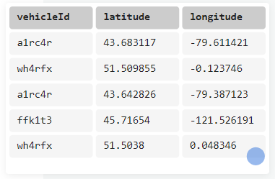
Collections
Durable storage : Streams
provide durable storage for sequences of events
offers two kinds of collections: streams and tables
Both operate under a simple key/value model
ksqlDB leverages Kafka for its storage layer
creating a new collection equates to defining a stream or a table over a Apache Kafka topic
can declare a collection over an existing topic
or can create a new topic for the collection at declaration time
Streams
immutable, append-only collections
useful for representing a series of historical facts
Adding multiple events with the same key means that they are simply appended to the end of the stream

Slide 8
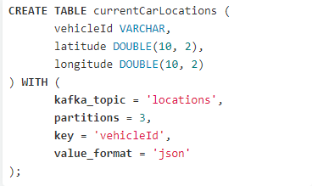
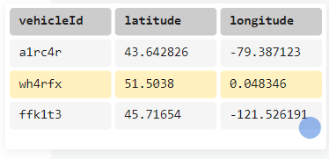
Collections (2)
Durable storage : Tables
Tables
mutable collections
represent the latest version of each value per key
helpful for modeling change over time, and they're often used to represent aggregations

Slide 9
Materialized Views
Derived from collections to maintain state
Derived representations of streams or tables
enable to create new collections over existing streams or tables
perpetually kept up to date as new events arrive
means that you can chain materialized views together to create many representations of the same data
especially useful for maintaining aggregated tables of data

Slide 10
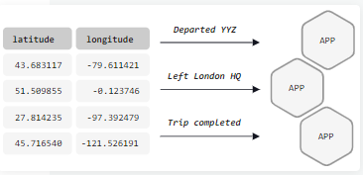
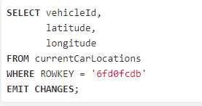
Queries
Allows data access : Push
Enable to access the materializations from applications or microservices
Applications can query materialized views with pull queries and push queries
Push queries
enable you to subscribe to materialized view updates and stream changes
When new events arrive, push queries emit refinements
Event streaming applications can react to new information in real-time
good fit for asynchronous application flows

Slide 11
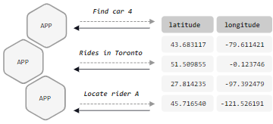
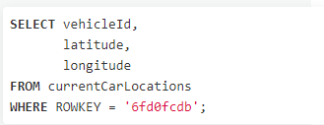
Queries(2)
Allows data access : Pull
Pull queries
enable you to fetch the current state of a materialized view
updated incrementally as new events arrive
pull queries run with predictably low latency
good fit for request/response flows

Slide 12
Thank You!
Reference:
ksqlDB Overview
https://docs.ksqldb.io/en/v0.7.0-ksqldb/
In our next session:

